Slide 1
CS3006 Parallel and Distributed Computing
FALL 2022
National University of Computer and Emerging Sciences

Slide 2
Chapter 3. Principles of Parallel Algorithm Design

Slide 3
A Parallel algorithm is a recipe that tells us how to solve a given problem using multiple processors.
At the very least, concurrency should be there and the algorithm designer must specify sets of steps that can be executed simultaneously.

Slide 4
Constructing a Parallel Algorithm
Identifying portions of the work that can be performed concurrently
Mapping the concurrent pieces of work onto multiple processes running in parallel.
Distributing the input, output, and intermediate data associated with the program.
Managing accesses to data shared by multiple processors.
Synchronizing the processors at various stages of the parallel program execution.
Notes:
Identify ATOMIC block

Slide 5
Decomposition, Tasks, and Dependency Graphs
Decomposition: dividing a computation into smaller parts, some or all of which may potentially be executed in parallel.
Tasks are programmer-defined units of computation .
Tasks can be of arbitrary size, but once defined, they are regarded as indivisible units of computation.
In general, some tasks may use data produced by other tasks and thus may need to wait for these tasks to finish execution.
An abstraction used to express such dependencies among tasks and their relative order of execution is known as a task dependency graph.

Slide 6
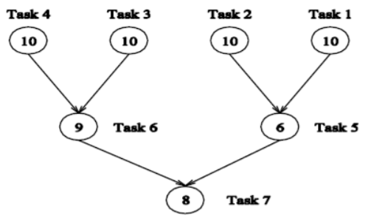
Dependency Graph
Node represent s task.
Directed edge represents control dependence.

Slide 7
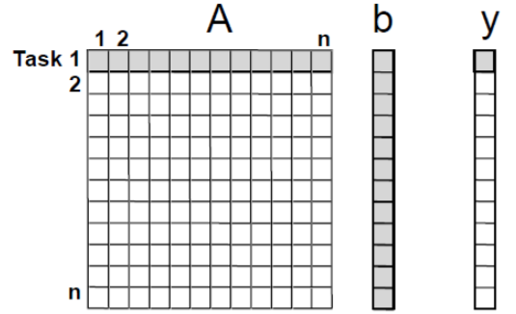
Example 1: Dense Matrix-Vector Multiplication
The computation of each y[i] can be regarded as a task.
All tasks are independent and can be performed all together or in any sequence.

Slide 8
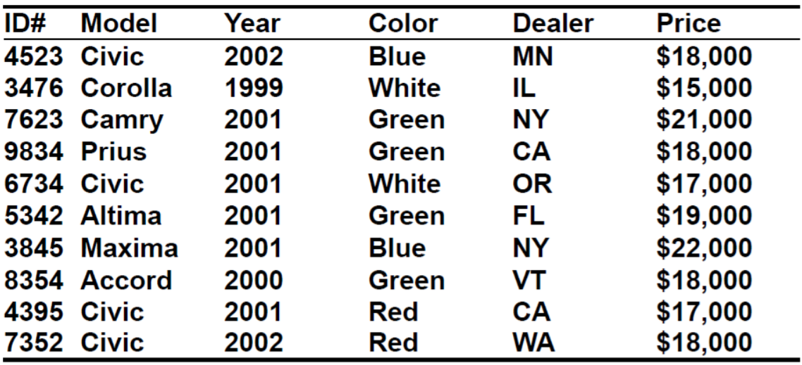
Example 3.2 Database query processing
Executing the query: (on the following database)
Model =“civic” AND Year = “2001” AND (Color = “green” OR Color = “white”)

Slide 9
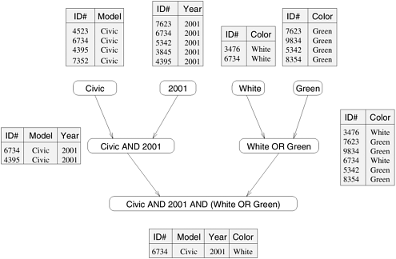
Notes:
this query is processed by creating a number of intermediate tables.
One possible way is to first create the following four tables: a table containing all Civics, a table containing all 2001-model cars, a table containing all green-colored cars, and a table containing all white-colored cars. Next, the computation proceeds by combining these tables by computing their pairwise intersections or unions.

Slide 10
Often there are multiple ways of expressing certain computations, especially those involving associative operators such as addition, multiplication, and logical AND or OR.
Different ways of arranging computations can lead to different task-dependency graphs with different characteristics.

Slide 11
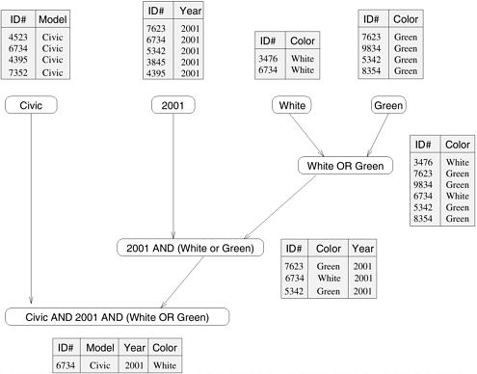
3.3 An alternate Data-Dependency Graph

Slide 12
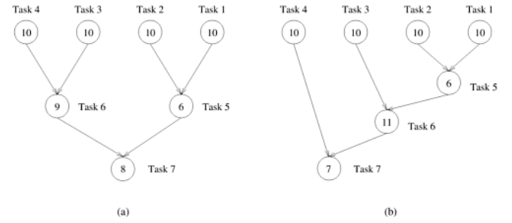
Figure 3.5 Abstractions of the task graphs of Figures 3.2 and 3.3, respectively.

Slide 13
Agglomeration
Agglomeration. The task and communication structures defined in the first two stages of a design are evaluated with respect to performance requirements and implementation costs. If necessary, tasks are combined into larger tasks to improve performance or to reduce development costs.
Agglomeration is almost always beneficial if analysis of communication requirements reveals that a set of tasks cannot execute concurrently.

Slide 14
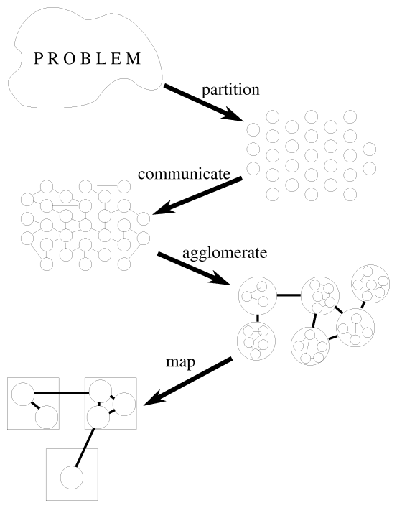
Notes:
Mapping: The mechanism by which tasks are assigned to processes.

Slide 15
Granularity, Concurrency, and Task-Interaction
The number and size of tasks into which a problem is decomposed determines the granularity of the decomposition.
A decomposition into a large number of small tasks is called fine-grained and a decomposition into a small number of large tasks is called coarse-grained.

Slide 16
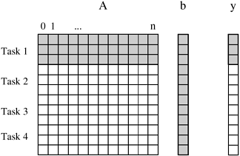
Matrix-vector multiplication example –
coarse-grain: each task computes 3 elements of y[]

Slide 17
Degree of Concurrency: # of tasks that can execute in parallel
maximum degree of concurrency: largest # of concurrent tasks at any point of the execution
average degree of concurrency: average # of tasks that can be executed concurrently
Degree of Concurrency vs. Task Granularity – Inverse relation

Slide 18
Increasing Granularity
A large number of fine-grained tasks does not necessarily produce an efficient parallel algorithm.
Communication costs and task creation costs are overhead that can be reduced by increasing granularity.

Slide 19
Critical path: The longest directed path between any pair of start node (node with no incoming edge) and finish node (node with no outgoing edges).
Critical path length: The sum of weights of nodes along critical path. – The weights of a node is the size or the amount of work associated with the corresponding task
Average degree of concurrency = total amount of work / critical path length

Slide 20
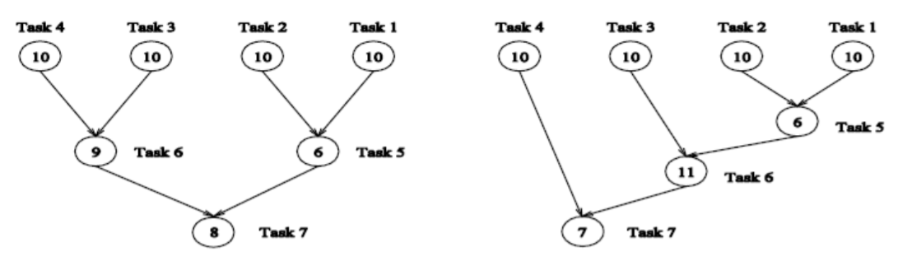
Left graph:
Critical path length = 27
Average degree of concurrency = 63/27 = 2.33
Right graph:
Critical path length = 34
Average degree of concurrency = 64/34 = 1.88
Notes:
Atomic Operations

Slide 21
Task Interaction Graph
Tasks often share input, output, or intermediate data, which may lead to interactions not shown in task-dependency graph.
there may be interactions among tasks that appear to be independent in a task dependency graph
E.g. For the matrix-vector multiplication problem, all tasks are independent, and all need access to the entire input vector b.
The pattern of interaction among tasks is captured by what is known as a task-interaction graph.
The edges in a task interaction graph are usually undirected, but directed edges can be used to indicate the direction of flow of data, if it is unidirectional

Slide 22
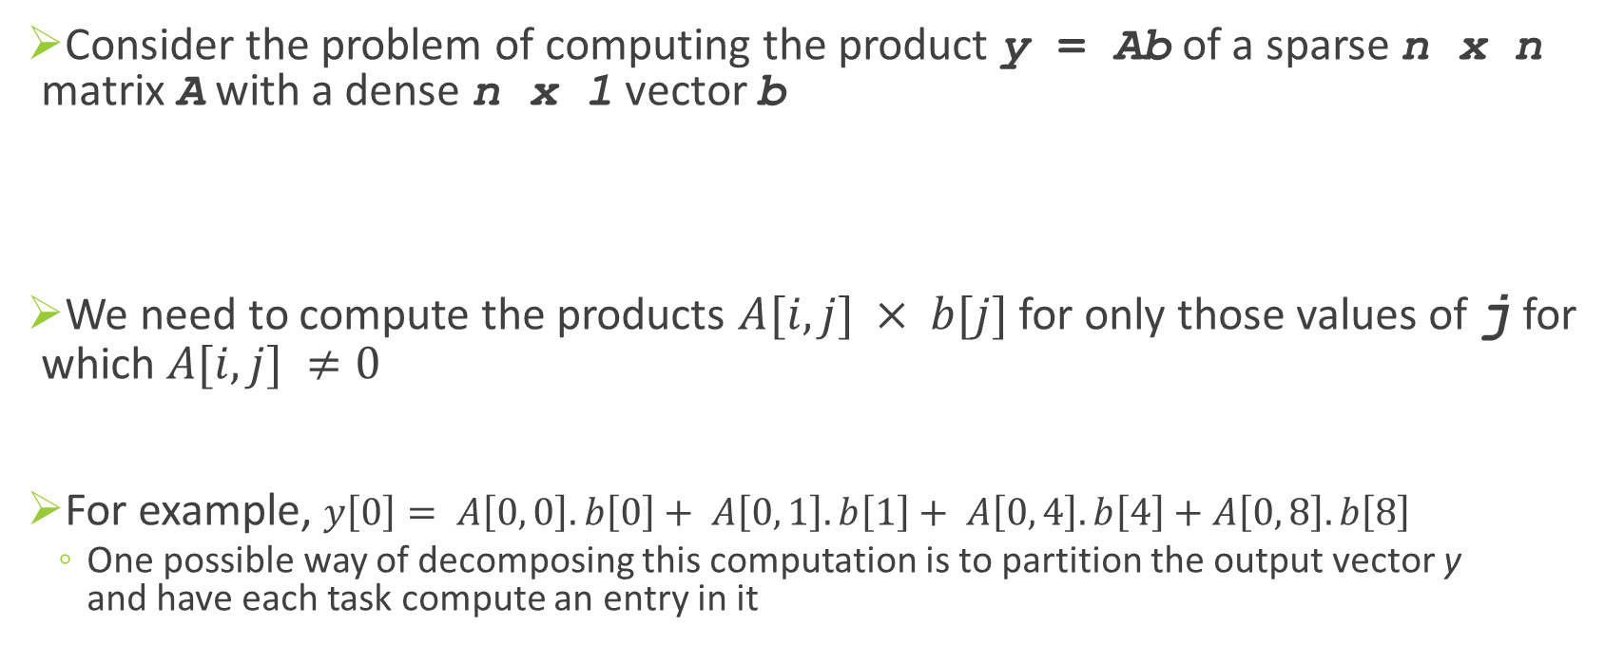
Example 3.3 Sparse matrix-vector multiplication
Consider the problem of computing the product y = Ab of a sparse n x n matrix A with a dense n x 1 vector b
We need to compute the products $A[i, j] × b[j]$ for only those values of j for which $A[i, j] ≠0$
For example, $y\left[0\right]= A\left[0, 0\right].b\left[0\right]+ A\left[0, 1\right].b\left[1\right]+ A\left[0, 4\right].b\left[4\right]+A\left[0, 8\right].b\left[8\right]$
One possible way of decomposing this computation is to partition the output vector y and have each task compute an entry in it
Notes:
A matrix is considered sparse when a significant number of entries in it are zero and the locations of the non-zero entries do not conform to a predefined structure or pattern. Arithmetic operations involving sparse matrices can often be optimized significantly by avoiding computations involving the zeros.

Slide 23
Task i, computes the element y[i] and also also make it the "owner" of row A[i, *] of the matrix and the element b[i] of the input vector.
Note that the computation of y[i] requires access to many elements of b that are owned by other tasks. So Task i must get these elements from the appropriate locations.
In the message-passing paradigm, with the ownership of b[i], Task i also inherits the responsibility of sending b[i] to all the other tasks that need it for their computation.
For example, Task 4 must send b[4] to Tasks 0, 5, 8, and 9 and must get b[0], b[5], b[8], and b[9] to perform its own computation .
Notes:
OWNER COMPUTE rule in Sparse Matrix Multiplication

Slide 24
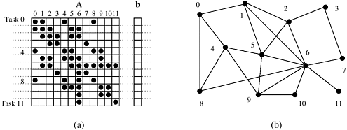

Slide 25
Processes and Mapping
Process: is a program, its local memory, and its communication inports and outports
Mapping. Each task is assigned to a processor in a manner that attempts to satisfy the competing goals of maximizing processor utilization and minimizing communication costs.
In general, the number of tasks in a decomposition exceeds the number of processing elements available.
For this reason, a parallel algorithm must also provide a mapping of tasks to processes.

Slide 26
Processes and Mapping
Note: We refer to the mapping as being from tasks to processes, as opposed to processors. This is because typical programming APIs, as we shall see, do not allow easy binding of tasks to physical processors. Rather, we aggregate tasks into processes and rely on the system to map these processes to physical processors. We use processes, not in the UNIX sense of a process, rather, simply as a collection of tasks and associated data.

Slide 27
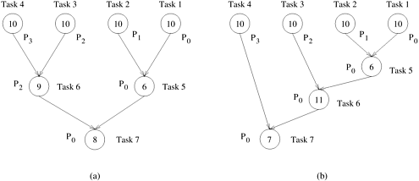
Figure 3.7. Mappings of the task graphs of Figure 3.5 onto four processes

Slide 28
Processes versus Processors
Processes are logical computing agents that perform tasks.
Processors are the hardware units that physically perform computations
In most cases, when we refer to processes in the context of a parallel algorithm, there is a one-to-one correspondence between processes and processors and it is appropriate to assume that there are as many processes as the number of physical CPUs on the parallel computer

Slide 29
Decomposition Techniques
While there is no single recipe that works for all problems, we present a set of commonly used techniques that apply to broad classes of problems
Recursive Decomposition
Data Decomposition
Exploratory Decomposition
Speculative Decomposition

Slide 30
Recursive Decomposition
A method for inducing concurrency in problems that can be solved using the divide-and-conquer strategy.
A problem is solved by first dividing it into a set of independent sub-problems
Notes:
Task: identify a problem which can be solved by recursive decomposition.

Slide 31
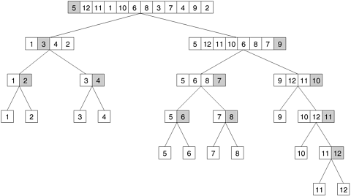
Example: … .
Notes:
Q: How does it support parallel execution?
Q: Does the diagram show task graph?
-concurrency continues to increase as we move down the tree.
-Given a scenario, ask for recursive decomposition of the task.

Slide 32
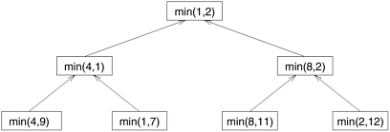
Sometimes, it is possible to restructure a computation to make it amenable to recursive decomposition even if the commonly used algorithm for the problem is not based on the divide-and-conquer strategy. For example:
1.procedure SERIAL_MIN (A, n)
2. begin
3. min = A[0];
4. for i := 1 to n - 1 do
5. if (A[i] < min) min := A[i];
6. endfor;
7. return min;
8. end SERIAL_MIN

Slide 33
A recursive program for finding the minimum in an array of numbers A of length n.
1. procedure RECURSIVE_MIN (A, n) 2. begin 3. if (n = 1) then 4. min := A[0]; 5. else 6. lmin := RECURSIVE_MIN (A, n/2); 7. rmin := RECURSIVE_MIN (&(A[n/2]), n - n/2); 8. if (lmin < rmin) then 9. min := lmin; 10. else 11. min := rmin; 12. endelse; 13. endelse; 14. return min; 15. end RECURSIVE_MIN

Slide 34
Data Decomposition
In this method, the decomposition of computations is done in two steps:
Step I: The data on which the computations are performed is partitioned, and
Step II: this data partitioning is used to induce a partitioning of the computations into tasks.
The operations that these tasks perform on different data partitions are usually similar (e.g., matrix multiplication) or are chosen from a small set of operations.

Slide 35
Partitioning Output Data
In many computations, each element of the output can be computed independently of others as a function of the input.
In such computations, a partitioning of the output data automatically induces a decomposition of the problems into tasks, where each task is assigned the work of computing a portion of the output.

Slide 36

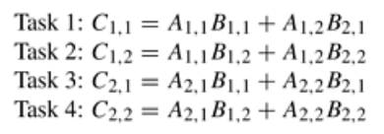
Example: 2 X 2 Matrices Multiplication
Notes:
In such a formulation, the matrix is viewed as composed of blocks or sub-matrices and the scalar arithmetic operations on its elements are replaced by the equivalent matrix operations on the blocks

Slide 37
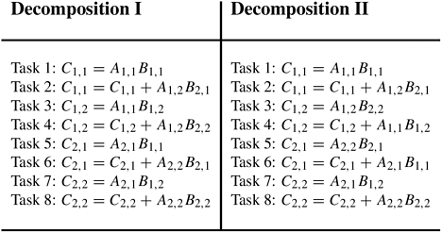
Two examples of decomposition of matrix multiplication into eight tasks.

Slide 38
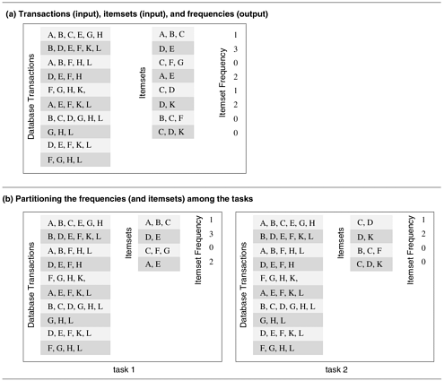
Example: Computing frequencies of itemsets in a Transaction Database
Notes:
Figure (b) shows how the computation of frequencies of the itemsets can be decomposed into two tasks by partitioning the output into two parts and having each task compute its half of the frequencies. Note that, in the process, the itemsets input has also been partitioned, but the primary motivation for the decomposition of Figure 3.12(b) is to have each task independently compute the subset of frequencies assigned to it.

Slide 39
Partitioning Input Data
Partitioning of output data can be performed only if each output can be naturally computed as a function of the input.
In many algorithms, it is not possible or desirable to partition the output data. For example, while finding the minimum, maximum, or the sum of a set of numbers, the output is a single unknown value.
In such cases, it is sometimes possible to partition the input data, and then use this partitioning to induce concurrency.

Slide 40
A task is created for each partition of the input data and this task performs as much computation as possible using these local data.
The solutions to tasks induced by input partitions may not directly solve the original problem. In such cases, a follow-up computation is needed to combine the results.
The problem of computing the frequency of a set of itemsets in a transaction database described in previous example can also be decomposed based on a partitioning of input data:

Slide 41
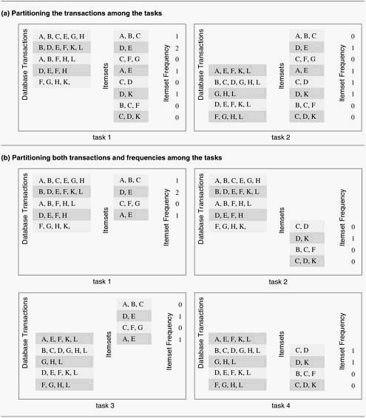

Slide 42
Partitioning both Input and Output Data

Slide 43
Partitioning Intermediate Data
Algorithms are often structured as multi-stage computations such that the output of one stage is the input to the subsequent stage.
Such an algorithm may be decomposed by partitioning the input or the output data of an intermediate stage of the algorithm.
Often, the intermediate data are not generated explicitly in the serial algorithm for solving the problem and some restructuring of the original algorithm may be required to use intermediate data partitioning
Partitioning intermediate data can sometimes lead to higher concurrency than partitioning input or output data

Slide 44
2 X 2 Matrices Multiplication of Output Data Partitioning
Max. Degree of Concurrency = 4
Notes:
In such a formulation, the matrix is viewed as composed of blocks or sub-matrices and the scalar arithmetic operations on its elements are replaced by the equivalent matrix operations on the blocks

Slide 45
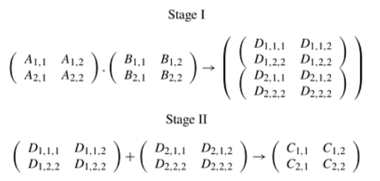
Reconsidering…. ( with intermediate data decomposition)

Slide 46
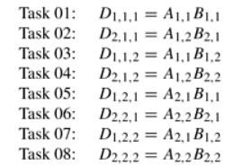


Slide 47
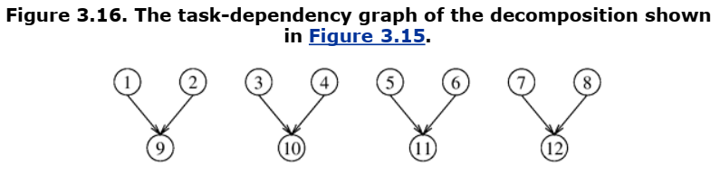

Slide 48
Exploratory Decomposition
Exploratory decomposition is used to decompose problems whose underlying computations correspond to a search of a space for solutions.
In exploratory decomposition, we partition the search space into smaller parts, and search each one of these parts concurrently, until the desired solutions are found.
Notes:
In which successive configurations or states of an instance are considered, with the intention of finding a goal state with a desired property.

Slide 49
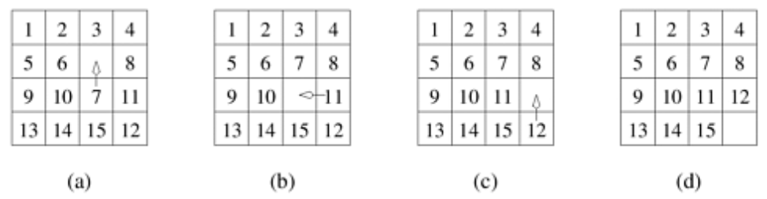
Example: the 15-Puzzle Problem
Notes:
The 15-puzzle is typically solved using tree-search techniques. Starting from the initial configuration, all possible successor configurations are generated. A configuration may have 2, 3, or 4 possible successor configurations, each corresponding to the occupation of the empty slot by one of its neighbors.

Slide 50
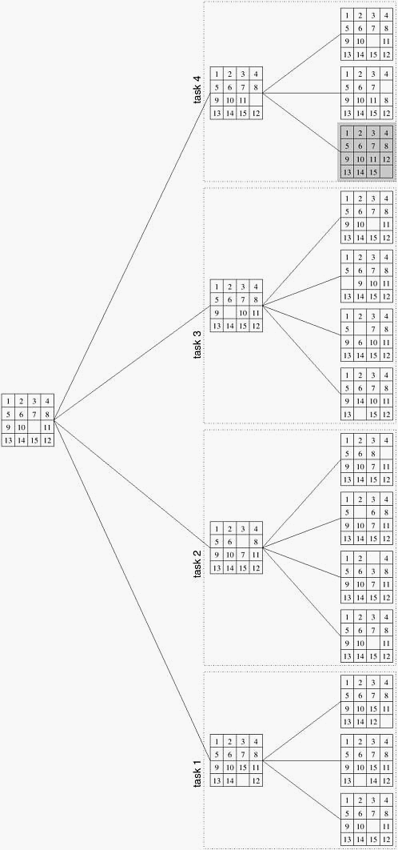
Parallel Execution
Notes:
As soon as one of the concurrent tasks finds a solution it can inform the others to terminate their searches.

Slide 51
Data Decomposition Vs Exploratory Decomposition
The tasks induced by data-decomposition are performed in their entirety and each task performs useful computations towards the solution of the problem.
On the other hand, in exploratory decomposition, unfinished tasks can be terminated as soon as an overall solution is found

Slide 52
The portion of the search space searched (and the aggregate amount of work performed) by a parallel formulation can be very different from that searched by a serial algorithm.
The work performed by the parallel formulation can be either smaller or greater than that performed by the serial algorithm.
Consider the different positions of solution.

Slide 53
Speculative Decomposition
Speculative decomposition is used when a program may take one of many possible computationally significant branches depending on the output of other computations that precede it.
Scenario is similar to evaluating one or more of the branches of a switch statement in C in parallel before the input for the switch is available.
While one task is performing the computation that will eventually resolve the switch, other tasks could pick up the multiple branches of the switch in parallel.
When the input for the switch has finally been computed, the computation corresponding to the correct branch would be used while that corresponding to the other branches would be discarded.

Slide 54
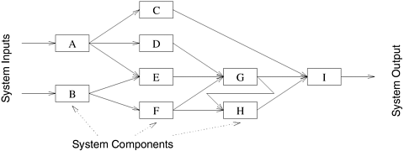
Example 3.8 Parallel discrete event simulation

Slide 55
Activity
Find the minimum of an array of size 16 using four tasks.

Slide 56
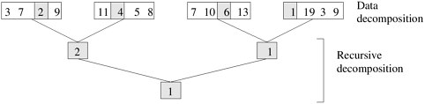
Hybrid Decompositions
Example: finding the minimum of an array of size 16 using four tasks.

Slide 57
PRACTICE TASK: Propose a Parallel Solution to the following

Slide 58
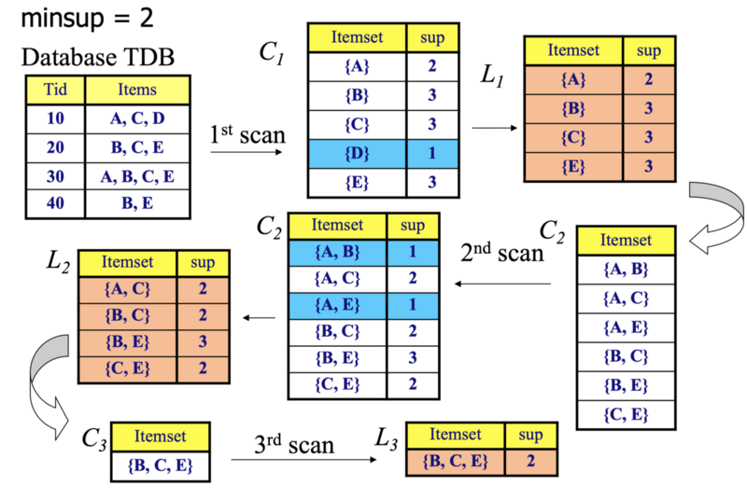

Slide 59
Mapping Techniques for Load Balancing
Once a computation has been decomposed into tasks, these tasks are mapped onto processes with the objective that all tasks complete in the shortest amount of elapsed time.
In order to achieve a small execution time, the overheads of executing the tasks in parallel must be minimized. The two key sources of overhead are:
The time spent in inter-process interaction.
The time that some processes may spend being idle.

Slide 60
Uneven load distribution may cause some processes to finish earlier than others.
At times, all the unfinished tasks mapped onto a process may be waiting for tasks mapped onto other processes to finish in order to satisfy the constraints imposed by the task-dependency graph.
Both interaction and idling are often a function of mapping, and it requires to achieve:
Reduce the amount of time processes spend in interacting with each other.
Reduce the total amount of time some processes are idle while the others are engaged in performing some tasks.

Slide 61
A good mapping must ensure that the computations and interactions among processes at each stage of the execution of the parallel algorithm are well balanced

Slide 62
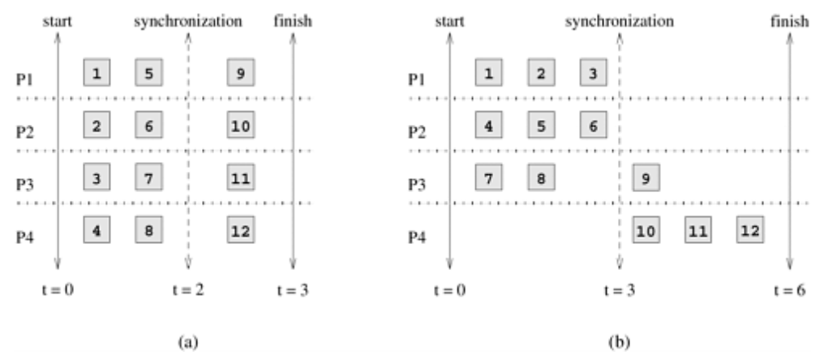
Figure 3.23
Notes:
Figure 3.23 shows two mappings of 12-task decomposition in which the last four tasks can be started only after the first eight are finished due to dependencies among tasks. As the figure shows, two mappings, each with an overall balanced workload, can result in different completion times

Slide 63
Static and Dynamic Mappings
Static Mapping techniques distribute the tasks among processes prior to the execution of the algorithm. Dynamic Mapping techniques distribute the work among processes during the execution of the algorithm.
For statically generated tasks, either static or dynamic mapping can be used. The choice of a good mapping in this case depends on several factors, including the knowledge of task sizes, the size of data associated with tasks, the characteristics of inter-task interactions, and even the parallel programming paradigm.

Slide 64
If tasks are generated dynamically, then they must be mapped dynamically too.
If task sizes are unknown, then a static mapping can potentially lead to serious load-imbalances and dynamic mappings are usually more effective.

Slide 65
Mappings Based on Task Partitioning

Slide 66
Figure shows a mapping of this task-dependency graph onto eight processes.
It is easy to see that this mapping minimizes the interaction overhead by mapping many interdependent tasks onto the same process (i.e., the tasks along a straight branch of the tree) and others on processes only one communication link away from each other.
The mapping shown in figure does not introduce any further idling and all tasks that are permitted to be concurrently active by the task-dependency graph are mapped onto different processes for parallel execution.

Slide 67
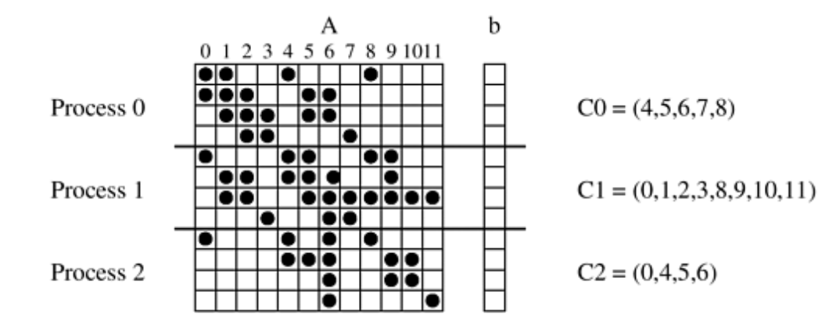
Example: Sparse Matrix Multiplication
Notes:
The list Ci contains the indices of b that Process i needs to access from other processes.

Slide 68
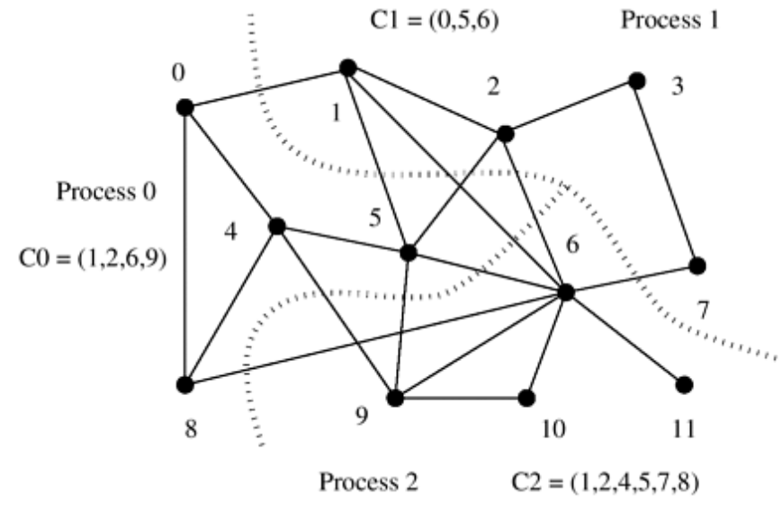
Reducing interaction overhead in sparse matrix-vector multiplication by partitioning the task-interaction graph.
Notes:
Assignment: How does this mapping is better than prvious one?

Slide 69
Parallel Algorithm Models: The Data-Parallel Model
In this model, the tasks are statically or semi-statically mapped onto processes and each task performs similar operations on different data
This type of parallelism that is a result of identical operations being applied concurrently on different data items is called data parallelism
The work may be done in phases and the data operated upon in different phases may be different
Typically, data-parallel computation phases are combined with interactions to synchronize the tasks or to get fresh data to the tasks.

Slide 70
Since all tasks perform similar computations, the decomposition of the problem into tasks is usually based on data partitioning because a uniform partitioning of data followed by a static mapping is sufficient to guarantee load balance

Slide 71
Parallel Algorithm Models: Task Graph Model
In the task graph model, the interrelationships among the tasks are utilized to promote locality or to reduce interaction costs.
This model is typically employed to solve problems in which the amount of data associated with the tasks is large relative to the amount of computation associated with them
Usually, tasks are mapped statically to help optimize the cost of data movement among tasks.
Examples: parallel quicksort, sparse matrix factorization, and many parallel algorithms derived via divide-and-conquer decomposition
This type of parallelism that is naturally expressed by independent tasks in a task-dependency graph is called task parallelism

Slide 72
Parallel Algorithm Models: The Work Pool Model
The work pool or the task pool model is characterized by a dynamic mapping of tasks onto processes for load balancing in which any task may potentially be performed by any process.
The work may be statically available in the beginning, or could be dynamically generated; i.e., the processes may generate work and add it to the global (possibly distributed) work pool
In the message-passing paradigm, the work pool model is typically used when the amount of data associated with tasks is relatively small compared to the computation associated with the tasks
As a result, tasks can be readily moved around without causing too much data interaction overhead

Slide 73
Parallel Algorithm Models: The Work Pool Model
E.g.
Parallelization of loops by chunk scheduling is an example of the use of the work pool model with centralized mapping when the tasks are statically available.
Parallel tree search where the work is represented by a centralized or distributed data structure is an example of the use of the work pool model where the tasks are generated dynamically

Slide 74
Parallel Algorithm Models: The Master-Slave Model
In the master-slave or the manager-worker model, one or more master processes generate work and allocate it to worker processes
The tasks may be allocated a priori if the manager can estimate the size of the tasks or if a random mapping can do an adequate job of load balancing.
In another scenario, workers are assigned smaller pieces of work at different times. This scheme is preferred if it is time consuming for the master to generate work and hence it is not desirable to make all workers wait until the master has generated all work pieces.

Slide 75
In some cases, work may need to be performed in phases, and work in each phase must finish before work in the next phases can be generated
In this case, the manager may cause all workers to synchronize after each phase.

Slide 76
Parallel Algorithm Models: The Pipeline or Producer-Consumer Model
In the pipeline model, a stream of data is passed on through a succession of processes, each of which perform some task on it.
This simultaneous execution of different programs on a data stream is called stream parallelism
With the exception of the process initiating the pipeline, the arrival of new data triggers the execution of a new task by a process in the pipeline.
The processes could form such pipelines in the shape of linear or multidimensional arrays, trees, or general graphs with or without cycles

Slide 77
Parallel Algorithm Models: The Pipeline or Producer-Consumer Model
A pipeline is a chain of producers and consumers.
Each process in the pipeline can be viewed as a consumer of a sequence of data items for the process preceding it in the pipeline and as a producer of data for the process following it in the pipeline.
The pipeline model usually involves a static mapping of tasks onto processes
Load balancing is a function of task granularity. The larger the granularity, the longer it takes to fill up the pipeline

Slide 78
Parallel Algorithm Models: Hybrid Models
In some cases, more than one model may be applicable to the problem at hand, resulting in a hybrid algorithm model.
A hybrid model may be composed either of multiple models applied hierarchically or multiple models applied sequentially to different phases of a parallel algorithm.

